Slide 1

Predicting the Volume of Border-Crossing
- Prashun Kafle

Slide 2

Problem Statement
Estimate the crossing volumes by port, border, measure type, and month.
Main Predictors used:
Port and date
Border type
Crossing category
Latitude/longitude
Year, month, seasonal month encoding
Lag and rolling historical volume

Slide 3
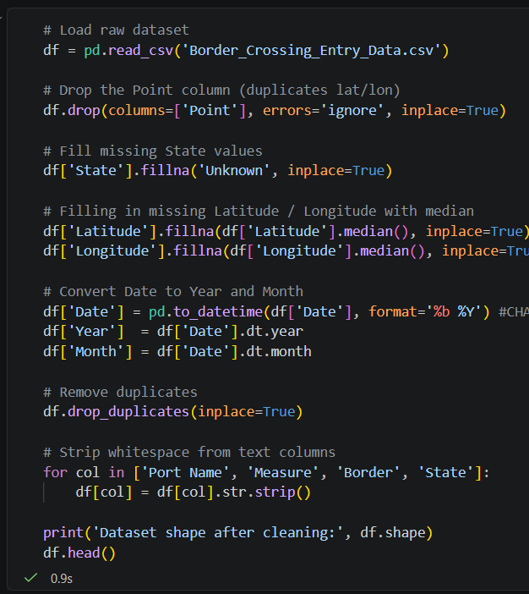
Previous work: Data Cleaning and Feature Engineering
Cleaning Mechanisms:
Dropped duplicate point coordinates, filled missing data, parsed date into year and month, removed duplicates
Feature engineering that raised accuracy:
Label-encoded categorical fields, sorted by port, measure, and date, created lag_1 and lag_3 history, added rolling mean and standard deviation, encoded seasonality with month sin/cos

Slide 4

Models Used
Linear Regression: Baseline Model to get an idea of the predictions,
Random Forest: Best balance of accuracy and non-linear pattern capture,
Histogram Gradient Boosting: Ensemble of trees to get a better idea of how the dataset behaves.
Best Model: Random Forest

Slide 5
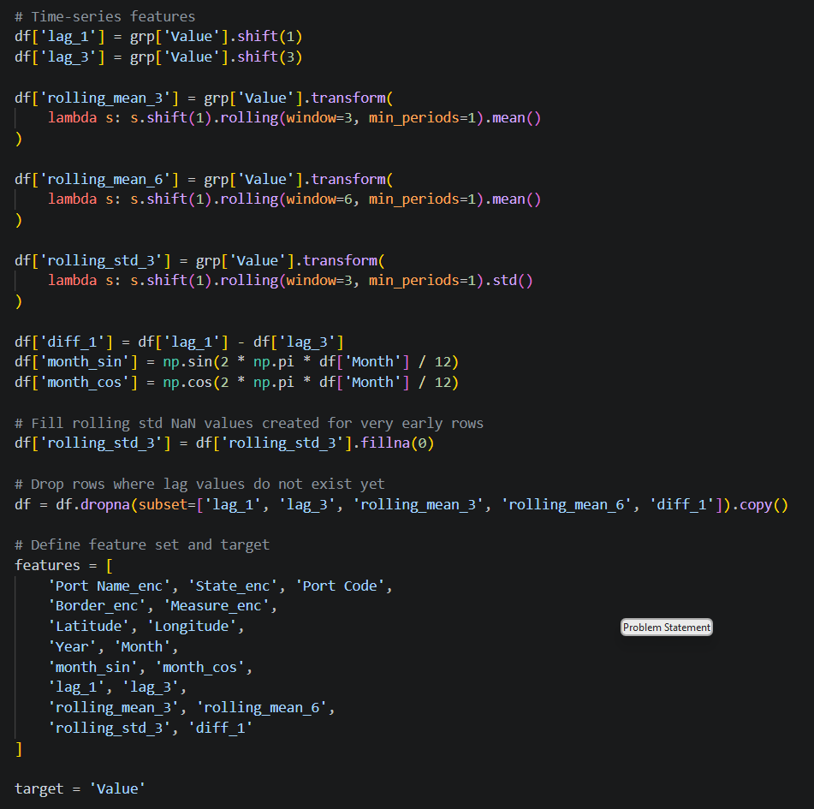
Major findings/lessons using the models
Learned a lot of new libraries
Too complex feature engineering will make things complex, and the model will overfit.
Time-based data splits are great for future forecasting

Slide 6
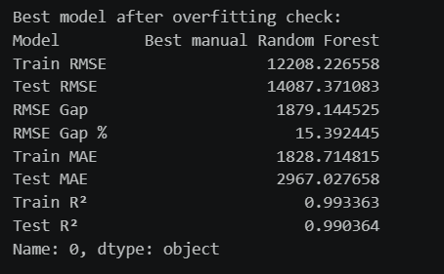
Highlights and Lowlights
Highlights:
Got to use a bunch of cool models
Learned a lot more about feature engineering
Lowlights:
Overfitting was a big problem
Models took ages to run

Slide 7
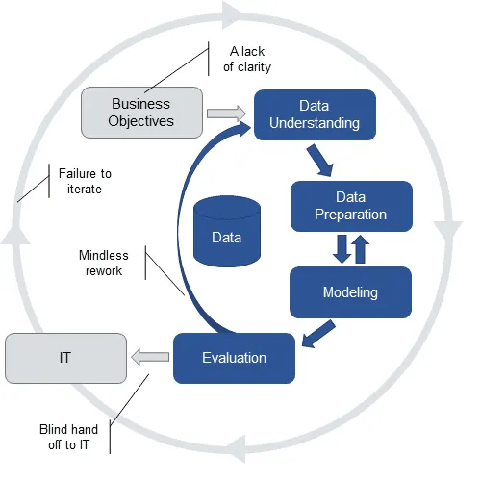
Deployment plan using CRISP-DM
Where it could be used: DHS/immigration and border operations planners.
How:
Intake monthly port-of-entry crossing records.
Apply the saved cleaning + feature pipeline.
Forecast volume by port, border, month, and crossing type.
Flag abnormal volume compared with expected traffic.
Give outputs that assist staffing, lane planning, and equipment allocation.

Slide 8
